Slide 1
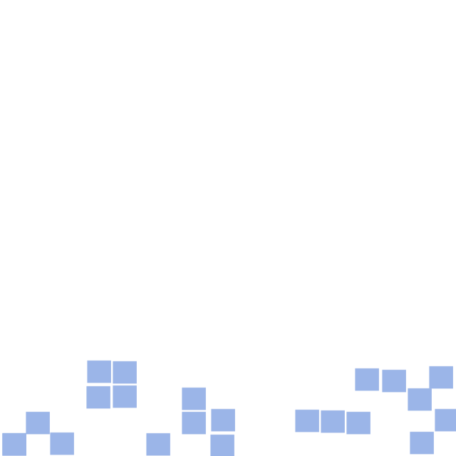
Conway's Game of Life
http://pavolondzik.github.io/GoL/
Pavol Ondzik
Denzel Dadson

Slide 2
Task
Create interactive implementation of
Conway’s Game of Life
User selects starting point for blinkers
System then sends gliders to destroy blinkers
OR
System randomly sets blinkers
Player sets starting point for gliders
System sends gliders from starting point
Notes:
Create an interactive implementation of the Game of Life grid, where a player can select starting points for a variety of blinkers. The system then sends gliders to destroy them, resulting in chaos. Alternatively, system randomly sets some blinkers and player sets starting point for gliders. Documentation should clearly explain algorithms used to generate the life-forms.

Slide 3
Cellular Automata
Emergence
Period
Speed
Rules
Cellular Automata in nature

Slide 4
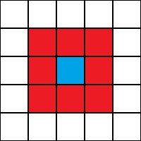
Conway's Game of Life
John Horton Conway, Scientific American (April 1970)
Cellular Automaton
Zero-player game
Field of cells, each has eight
neighbours ->
Moore neighbourhood.
A cell is either occupied (by an organism) or not.
Notes:
The three main components of a Cellular
Automata are:
➟The array dimension (Vast Parallelism: Cellular computing can
involve 10^5 or more cells)
➟The neighborhood structure (Locality)
➟The transition rule
(Simplicity): the basic processing element, the cell, is simple
is the smallest structural and functional unit of all living organisms, which has all the basic qualities of life. Jan Evangelista Purkyně,
Cellular Computing = simplicity + vast parallelism + locality

Slide 5









Rules for Conway’s Game of Life
Rules for deriving a generation from
the previous one :
Birth
Survival
Death
Notes:
Why Conway’s Game of life is Artificial Intelligence ? Because it uses these three simple rules of life.
A dead cell with exactly three live neighbours becomes a live cell (birth).
A live cell with two or three live neighbours stays alive (survival).
In all other cases, a cell dies or remains dead (overcrowding or loneliness).

Slide 6

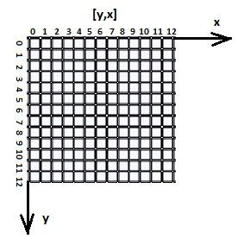
Patterns
Block (still life)
Blinker (period 2 oscillator)
Glider (spaceship)
Pulsar (period 3 oscillator)
Left-handed Cartesian coordinate system

Slide 7
Algorithm (1)
NextGen: toroidal array
Notes:
Algorithm of the solution …
NextGen
Life patterns are represented as two-dimensional arrays in computer memory. Typically two arrays are used, one to hold the current generation, and one in which to calculate its successor. Often 0 and 1 represent dead and live cells respectively. A nested for-loop considers each element of the current array in turn, counting the live neighbours of each cell to decide whether the corresponding element of the successor array should be 0 or 1. The successor array is displayed. For the next iteration the arrays swap roles so that the successor array in the last iteration becomes the current array in the next iteration.
In principle, the Life field is infinite, but computers have finite memory. This leads to problems when the active area encroaches on the border of the array. Programmers have used several strategies to address these problems. The simplest strategy is simply to assume that every cell outside the array is dead. This is easy to program, but leads to inaccurate results when the active area crosses the boundary. A more sophisticated trick is to consider the left and right edges of the field to be stitched together, and the top and bottom edges also, yielding a toroidal array. The result is that active areas that move across a field edge reappear at the opposite edge. Inaccuracy can still result if the pattern grows too large, but at least there are no pathological edge effects. Techniques of dynamic storage allocation may also be used, creating ever-larger arrays to hold growing patterns.

Slide 8
Algorithm (2)

Slide 9
Thank you for your attention!
Do you have any questions ?

Slide 10
References
http://www.math.com/students/wonders/life/life.html
http://en.wikipedia.org/wiki/Conway%27s_Game_of_Life
http://www.julianpulgarin.com/canvaslife/

